Slide 1
Loops
Course Code: CSC1102 &1103
Course Title: Introduction to Programming
Dept. of Computer Science
Faculty of Science and Technology
Lecturer No: | 4 | Week No: | 2 (1X1.5 hrs), 3 (1X1.5 hrs) | Semester:
Lecturer: | Syeda Nishat Tasnim(nishat@aiub.edu)

Slide 2
Lecture 4: Outline
for Loops
Increment Operator
Program Input
for Loop Variants
The while Statement
The do Statement
The break Statement
The continue Statement

Slide 3
Program Looping
Looping: doing one thing over and over
Program loop: a set of statements that is executed repetitively for a number of times
Simple example: displaying a message 100 times
Program looping: enables you to develop concise programs containing
repetitive processes that could otherwise require many lines of code !

Slide 4
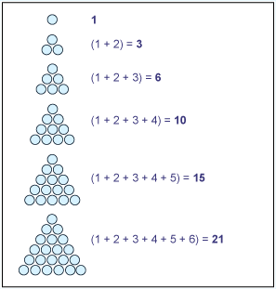
Example – 200th triangular number flowchart
Statement before loop
triNum = 0
Some Triangular number examples
initialization loop control variable
n=1
n<=200
no
Loop condition
yes
Statements inside
Loop
triNum = triNum + n
Updating loop control
variable
n=n+1
Statement after loop
Print triNum

Slide 5
Example - for
/* Program to calculate the 200th triangular number
Introduction of the for statement */
#include<iostream>
using namespace std;
int main ()
{
int n, triNum;
triNum = 0;
for ( n = 1; n <= 200; n = n + 1 )
triNum = triNum + n;
cout<<"The 200th triangular number = " << triNum;
return 0;
}

Slide 6
The for statement
for ( init_expression; loop_condition; update Expression){
program statements. . .
}
1
init_expression
loop_condition
no
5
2
yes
3
Program statement
4
Loop expression
After Loop

Slide 7
The for statement
no
1
2
5
4
for ( n = 1; n <= 200; n = n + 1 ){
triNum = triNum + n;
}
yes
3
6

Slide 8
How for works
The execution of a for statement proceeds as follows:
The initial expression is evaluated first. This expression usually sets a variable that will be used inside the loop, generally referred to as an index variable, to some initial value.
The looping condition is evaluated. If the condition is not satisfied (the expression is false – has value 0), the loop is immediately terminated. Execution continues with the program statement that immediately follows the loop.
The program statement that constitutes the body of the loop is executed.
The looping expression is evaluated. This expression is generally used to change the value of the index variable
Return to step 2.

Slide 9
Infinite loops
It’s the task of the programmer to design correctly the algorithms so that loops end at some moment !
// Program to count 1+2+3+4+5
int main (void)
{
int i, n = 5, sum =0;
for ( i = 1; i <= n; n = n + 1 ){
sum = sum + i;
cout<<sum<<endl;
}
return 0;
}
What is wrong here ?
Does the loop end?

Slide 10
Relational operators
Operator | Meaning
== | Is equal to
!= | Is not equal to
< | Is less than
<= | Is less or equal
> | Is greater than
>= | Is greater or equal
The relational operators have lower precedence than all arithmetic operators:
a < b + c is evaluated as a < (b + c)
ATTENTION ! Do not confuse:
the “is equal to” operator == and the “assignment” operator =
ATTENTION when comparing floating-point values !
Only < and > comparisons make sense !

Slide 11
Increment operator
Because addition by 1 is a very common operation in programs, a special operator was created in C for this.
Increment operator: the expression ++n is equivalent to the expression n = n + 1.
Decrement operator: the expression --n is equivalent to the expression n = n – 1
Increment and decrement operators can be placed in front (prefix) or after (postfix) their operand.
The difference between prefix and postfix:
Example: if n=4:
a=n++ leads to a=4, n=5
a=++n leads to a=5, n=5

Slide 12
If you use the ++ operator as a prefix like: ++var, the value of var is incremented by 1; then it returns the value.
If you use the ++ operator as a postfix like: var++, the original value of var is returned first; then var is incremented by 1.

Slide 13
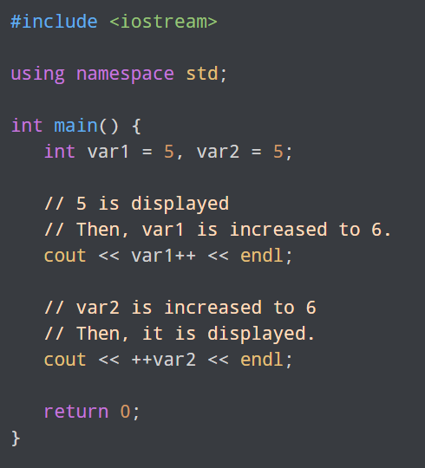

Slide 14
The while statement
while ( expression ){
program statements . . .
}
while ( number <= 0 )
{
cout<<“The number must be >0“<<endl;
cout<<“Give a new number: “<<endl;
cin>>number;
}

Slide 15
The while statement
Loop with the test in the beginning !
Body might never be executed !
Loop_expression
no
yes
statement

Slide 16
Program to calculate the 200th triangular number Using while Loop
#include<iostream>
using namespace std;
int main ()
{
//Statements before loop
int n, triNum;
triNum = 0;
n = 1; //initialization loop control variable
while (n <= 200){//while loop condition
triNum = triNum + n; //Statements inside loop
n = n + 1;
}
//Statements after loop
cout<<"The 200th triangular number = " << triNum;
return 0;
}

Slide 17
Example - while
/* Program to find the greatest common divisor
of two nonnegative integer values */
#include <iostream>
using namespace std;
int main (void)
{
int u, v, temp;
cout<<"Please type in two nonnegative integers."<<endl;
cin>>u>>v;
while ( v != 0 ) {
temp = u % v;
u = v;
v = temp;
}
cout<<"Their greatest common divisor is "<< u;
return 0;
}

Slide 18
Example:
A program to print out the digits of a number in reverse order …

Slide 19
Example – Flowchart for Printing the digits of a number in reverse order.
Start
Input number
false
number > 0
true
right_digit = number%10
Print right_digit
End
number = number / 10

Slide 20
Example - while
// Program to reverse the digits of a number
#include <iostream>
using namespace std;
int main ()
{
int number, right_digit;
cout<<"Enter your number"<<endl;
cin>>number;
while ( number != 0 ){
right_digit = number % 10;
cout<< right_digit;
number = number / 10;
}
return 0;
}

Slide 21
The do{}while() statement
do{
program statements . . .
}
while ( loop_expression );
Loop with the test at the end !
Body is executed at least once !
statement
loop_expression
yes
no

Slide 22
Which loop to choose ?
Criteria: Who determines looping
Entry-condition loop -> for, while
Exit-condition loop -> do
Criteria: Number of repetitions:
Indefinite loops ->while
Counting loops -> for
You can actually rewrite any while as a for and viceversa !

Slide 23
The break Statement
Can be used in order to immediately exiting from a loop
After a break, following statements in the loop body are skipped and execution continues with the first statement after the loop
If a break is executed from within nested loops, only the innermost loop is terminated

Slide 24
The break statement
//Programming style: don’t abuse break !!!
...
while ( number != 0 ) {
// Statements to do something in loop
cout<<"Stop, answer 1:” <<endl;
cin>>answer;
if(answer == 1)
break; // very bad idea to do this
}

Slide 25
The continue statement
Similar to the break statement, but it does not make the loop terminate, just skips to the next iteration

Slide 26
Example - continue statement
#include <iostream>
using namespace std;
int main()
{
// loop from 1 to 10
for (int i = 1; i <= 10; i++) {
/* If i is equals to 6, continue to next iteration without printing */
if (i == 6)
continue;
else
cout << i << " "; // otherwise print the value of i
}
return 0;
}

Slide 27
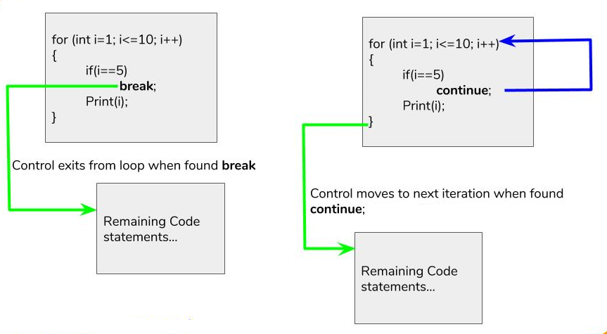
Difference between break and continue

Slide 28
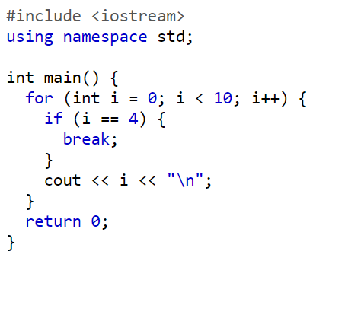


Slide 29
